Slide 2
The Writer’s Notebook
A Tool for Writing in Any Genre

Slide 3
Beliefs About Keeping a Writer’s Notebook
It’s a place where a writer explores his/her thinking.
It’s a reflection of who the writer is at any given time.
It’s a tool where a writer makes decisions about his/her own writing.
Rereading the notebook helps a writer to explore topics more deeply or in a new way.
As a writer becomes more diligent in keeping a notebook, the notebook will evolve in its purpose.

Slide 4
The Writing Workshop
The Mini-Lesson - Teach
Writing – Independent, Guided, Shared
Share – Summarize / Respond

Slide 5
Essence of the Writer’s Notebook:
A writer’s notebook is not a journal but a place for us to live a writerly life. Within the pages of an otherwise plain notebook, a writer finds interest and significance in the ordinary. With reflection, observation, and some imagination, writers can sow the seeds for future writing.
The audience for a writer’s notebook is the writer herself – not the teacher, not an editor, not a parent. Once the writer turns his attention to an audience other than himself, he leaves the notebook and begins to draft, twitter or even blog.

Slide 6
Student Expectations
Write daily
Self-select topics
Try strategies from mini-lesson
Fold over private entries
Respect your notebook and others
Practice what you know about GUMS

Slide 7
Students Can Expect Teachers to…
Provide time
Demonstrate strategies to find topics
Teach mini-lessons on craft and genre structure
Respect personal entries
Keep a notebook of their own and share from it frequently
Teach the rules for GUMS in a meaningful way

Slide 8
Ready or Not?
Looking for cues that students are ready for writer’s notebooks.

Slide 9
8 Cues a Student Is Ready for a Notebook
Word Wise
Fine Motor Skills
Fluency
Reading Level
Stamina
Abstract Thinking
Maturity
Habits of Mind

Slide 10
Launching the Writer’s Notebook
Purpose: To get to know your students as writers
To help your students begin to develop their own
writing voice
To invite students into the writerly life
To find significance in the ordinary
Notes:
What do writers do? They write. They write about themselves, their pets, their questions, their observations, and things they wonder about. They write every day and sometimes at night!

Slide 11
History of a Name
What’s the background story about your name? your pet’s name? the name of a battle in WWII?

Slide 12
Fierce Wonderings
Write about what you wonder…

Slide 13
Observations
What do you notice about the world around you? If writing about a certain topic – or researching a topic- what do you notice about it?

Slide 14
Developing Ideas
These strategies helps students develop writing ideas beyond a paragraph. Often, these strategies will lead to new or more specific writing ideas.

Slide 15
Respond to the World
Has something in the news caught your attention? Has something happened in your world about which you have something to say?

Slide 16
Write From a Word
Any word can lead our mind towards a variety of topics. This is a good strategy when trying to find a topic of importance. It’s also helpful when trying to focus on exploring a particular angle of a writing topic.

Slide 17
Authors as Mentors
Students can learn a lot from looking at one small part of an author’s craft. While a whole text may be overwhelming, a sentence, page, or paragraph may be more manageable.

Slide 18
A mentor text is…
…an example we want our students to follow.
…long enough for students to get the gist.
… short enough to read
and study within a mini-lesson.
…within reach
of our students’
abilities to emulate.

Slide 19
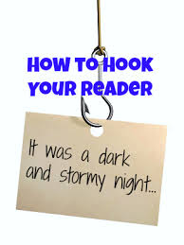
GO FISHING
The internet has a ton of samples from teachers just like you.
WARNGING: It’s addicting and may take up a lot of your time.
Know what you are looking for – craft idea or teaching point.
Collect and bookmark websites that are helpful.
Always put ‘ for kids’ after your search phrase.
Search for typed text or full text

Slide 20

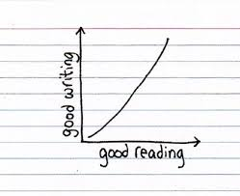
LOVE a Book
READ a favorite book and mark all of your favorite parts.
THINK about how the writer did it.
NAME the technique. Make it up if you have to do so.
TRY it out in your writing or teaching.

Slide 21

When Mr. Slinger had bus duty,
Lilly stood in line even though she didn't ride the bus.
Lily raised her hand
more than anyone else in class
(even if she didn't know the answer).
And she volunteered to stay
after school to clap erasers.
"I want to be a teacher
when I grow up," said Lilly.
"Excellent choice," said Mr. Slinger.
From Lilly's Purple Plastic Purse by K. Henkes

Slide 22
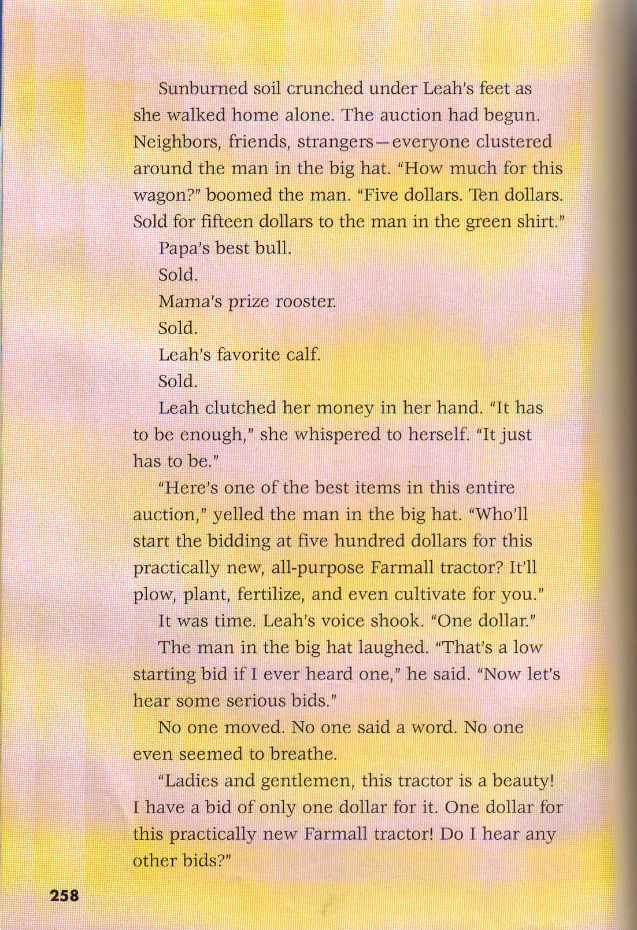
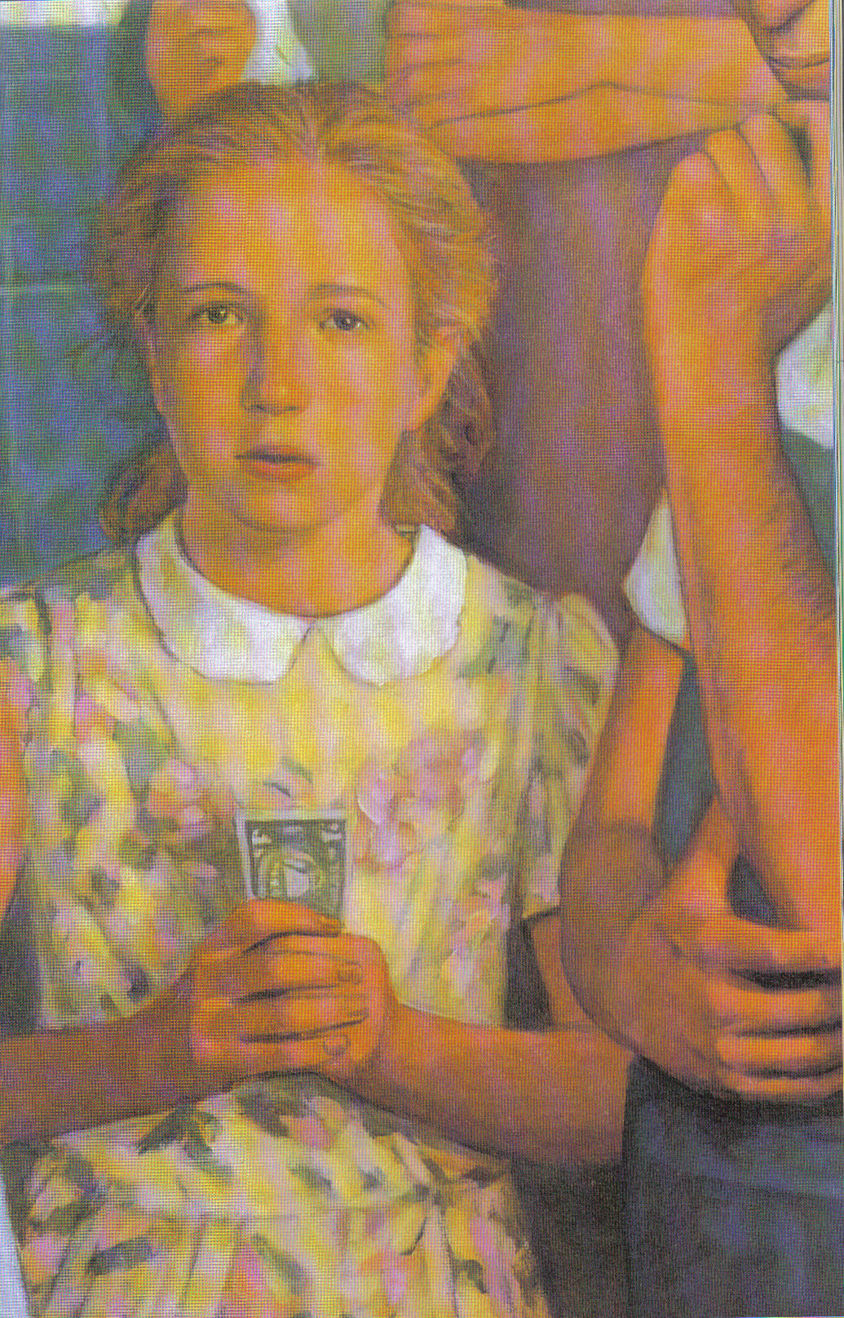
Notes:
Creating tension –
Edge of your seat kind of writing
Look at how tension is created. Ask teachers to think of a spot in their piece where they can create tension.

Slide 23
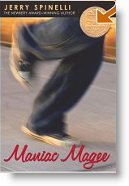
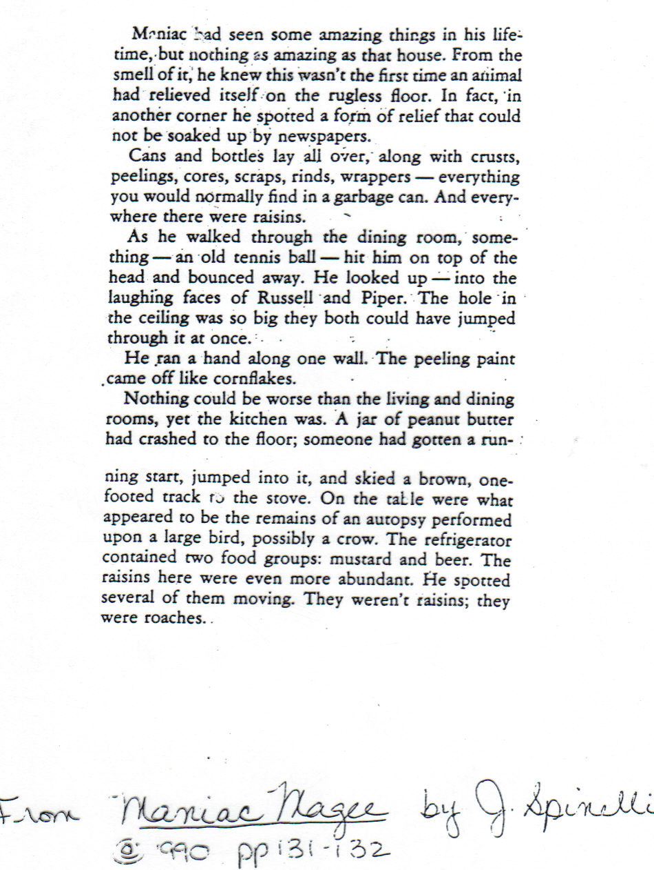
From Maniac Magee by J. Spinelli © 1990
pp.131=132
Notes:
Read and discuss the text. Have teachers note that this is a classic ‘show don’t tell’ piece. Have teachers think about a room in their house or a setting from their list and star and begin to show don’t tell.

Slide 24
John Henry sang and he hammered and the air danced and the rainbow shimmered and the earth shook and rolled from the blows of the hammer. Finally it was quiet. Slowly the dust cleared.
Folks could not believe their eyes. The boulder was gone. In its place was the prettiest and straightest road they had ever seen. Not only had John Henry pulverized the boulder into pebbles, he had finished building the road.
In the distance where the new road connected to the main one, the road crew saw John Henry waving good-bye, a hammer on each shoulder, the rainbow draped around him like love.
From John Henry, p 18
By Julius Lester, 1994
Notes:
Read and discuss. Note the way a long sentence without commas but lots of ‘ands’ can create an overwhelming affect like there are a lot of things happening at once.
Ask teachers to think of a moment in time that seems crazy and then tends to settle down – like getting ready for dismissal and then the quiet after the kids leave.
Give them a moment to try the long short short method.

Slide 25
From Goblins in the Castle pg.62
The corridor curved to the right. We stepped through an arch. I screamed as something jumped onto my back.
“Get it off!” I cried as the thing wrapped its long fingers in my hair.” Igor, get it off me!”
I heard Igor grunt. I swung around, trying to dislodge the attacker myself, and saw at lest eight more of the creatures coming at us.
I didn’t have time to study them. I remember only a sense of exaggerated features: big eyes, huge noses, flapping ears. Beyond that it was chaos as they came bounding out of the darkness.
The goblin on my back was shrieking with delight. Igor was roaring with fury. “Get off that William!” he cried, lashing out with his bear and whacking the goblin that clung to me. It bounced away, taking some of my skin with it.
The others hurried on, screaming, shouting, grabbing at Igor. He lashed out with his bear, swinging it to the right and the left. “Bop!” he cried. “Bop, bop, bop! Take that, goblin! And that, and that!”
I found that by using the torch I could drive some of them back. Igor’s frenzied strength was terrible to see. In only a moment the goblins fled shrieking into the darkness.

Slide 26
For the LOVE of Grammar
Or rather the necessity of it…

Slide 27
Grammar in the Workshop
- Concept impacts student writing
- Students can practice the concept in their writing.
- Students can use the concept in their writing in an artful way.

Slide 28
Grammar in the WW
How:
1. Create a statement that explains why writers need to know and use the concept.
2. Find or create a mentor text that demonstrates the use of the concept.
3. Create a notebook page to keep notes and ‘try –outs’ for students to reference.
4. Invite students to find opportunities to practice the concept.

Slide 29
Example
Writers can use compound sentences to help create an image in the reader’s mind.
The weather had been clear and cold, and thousands of stars decorated the inky blackness of night.
From Ziggy and the Black Dinosaurs: The Space Mission by Sharon Draper (p1)
TRY IT: Write a compound sentence to create an image in the reader’s mind. You can try writing about the weather, like the sample. What else – besides the weather – could you use apply this?
INVITE: Ask students to collect compound sentences that create images in their mind from books they are reading. Ask students to share ones they write.

Slide 30
Three Things to Consider When Teaching G.U.M.S.
1. Will the lesson impact student writing?
2. Will the student be required to use the lesson on a standardized test?
3. Is the concept directly related to the spelling of the word?

Slide 31
A Writer’s Notebook Meets Non-Fiction
Notebook Strategies for Taking Notes and Writing Informational Pieces

Slide 32
A closer look at
RESEARCH TO BUILD AND PRESENT KNOWLEDGE
Conduct SHORT – as well as sustained – research projects
Gather relevant information from multiple print and digital resources while avoiding plagiarism
Be able to quote/cite evidence from informational texts to support analysis, reflection, and research.

Slide 33
Students Need A Vision
…teaching students to do the intellectual work involved in writing about a subject – any subject – means teaching them to organize and elaborate on facts and ideas, to decide on priorities, to look at information through different lenses and to entertain questions…
Pathways to the Common Core, 153

Slide 34
Thinking About Topic
Readers set a purpose for reading.
What is it I’m trying to learn from
this text?
Writers set a purpose for reading. What information do I need to support my writing?

Slide 35
Organizational Structures
There are some of the more common patterns students will come across in their reading. There are many more.
It’s helpful for students to have cues – other than the main idea – to determine the organization of a text.
If students are aware of the text structure it affects how they take notes.

Slide 36
Recomposition
The act of recomposing information in a different format so as to demonstrate understanding without plagiarism.
(Standards 1, 2, 3, 4, 5,6, 7, 8, 9*)

Slide 37
“Funky Fruit”
Excerpt from “Far-Out Foods,” by Diane Wedner
NGE, November 2010
FUNKY FRUIT
Maybe bugs don’t make your mouth water. Fruit is good, though, right? You might think that until you take a whiff of durian fruit. This fragrant fruit grows in Southeast Asia. To many people, its scent is anything but fruity. Durian is famous for its stink!
Durian grows as big as your head. The ripe fruit drops from a tree like a bowling ball. Watch out! It’s covered in spikes. You need a sharp knife and thick gloves to open it.
Why bother? If you can get past the smell, many people think durian is yummy. The roasted seeds taste like almonds. Some say the fruit tastes like vanilla. Others say it’s more like a mix of strawberry and garlic.
Like insects, durian is plentiful – and good for you. It’s high in fiber. That helps you digest your food. Its carbohydrates give you a real energy boost, too. Your body turns carbohydrates into a kind of sugar called glucose. What’s the best way to serve durian? Try pie, Davis recommends.
(movie)

Slide 39
Reread and Reflect
Readers: Reread notes and determine if the information is important enough to make note.
Writers: Reread note to determine which notes to keep and where they need more information.

Slide 40
When Students Reread and Reflect They:
Determine which notes are important and which ones are not
Ask more questions or find holes in their research
Compare information to confirm ‘facts.’
Realize if they need more information and the kind of information they need.
Synthesize information – combining notes and drawing conclusions

Slide 41

Stick It or Flick It
Not every sticky note is meant to be kept.

Slide 42
Boxes and Bullets
Planning, Note Taking, Organizing…

Slide 43
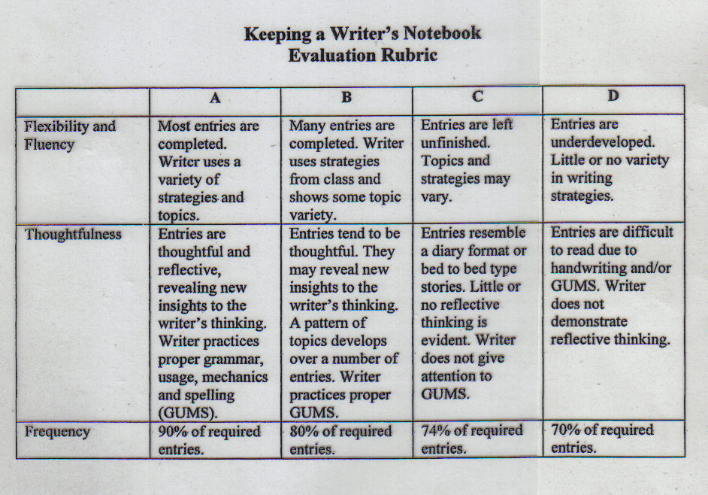
Notes:
Turn and talk – what are your expectations for how students keep a notebook and how you assess them?

Slide 44
From Notebooks to Final Pieces
Study mentor texts
Topic
Structure
Wording
Allow time to revise for creating voice through careful word choice
Carefully consider adding graphics to enhance the readers comprehension and to support the main idea(s) of the piece

Slide 45
Make a Plan
What are you willing to try with writing notebooks?
How do you envision the first few days? Strategies?
Think about the notebook as a quick unit of study or as an aid to a unit of study.

Slide 46
Gathering Texts
Where can you find samples of notebooks?
What mentor texts will you use to demonstrate or launch strategies?

Slide 47
Setting the Stage
What are your expectations of your students during this time?
What will be the outcome?

Slide 48
Immersion
Which texts will kids be free to explore and which will you use to share whole class?
How will students share their ideas about notebooks?

Slide 49
Close Study Questions
What kind of writing is this? How is it different from other kinds of writing in the world?
What kind of work does this kind of writing do? (Purpose, audience, topic?)
What different approaches do people take to writing this kind of thing?
How long is this kind of writing? Is it different lengths in different situations?

Slide 50
Writing Under the Influence
Do they try strategies?
Do they make decisions about strategies to use independently?
Do they create their own strategies to meet their writing needs?
Do they use mentor texts to play with writing styles?

Slide 51
Write often to write well.
“If you write one story, it may be bad; if you write a hundred you have the odds in your favor.”
- Edgar Rice Burroughs
aimeebuckner@gmail.com

