Slide 1
According to the National Reading Panel, what are the most effective reading strategies ?
Dine and Dish
Wednesday, October 30, 2013

Slide 2
The National Reading Panel concluded there was sufficient evidence supporting the teaching of seven comprehension strategies. These strategies
are:
Graphic Organizers
Asking Questions
Answering Questions
Monitoring
Summarizing
Story Mapping
Cooperative Grouping/Discussion
Two other strategies – prior knowledge and mental imagery were successful in many studies.

Slide 3
Should comprehension strategies be taught in isolation or in conjunction with other strategies?
Turn and talk to a partner.

Slide 4
The National Reading Panel concluded that the most learning was obtained when multiple strategies were taught in combination.

Slide 5
What are graphic organizers?
According to Table 6 in the Appendixes from the National Reading Panel Report: Practical Advice for Teachers, 2006, graphic organizers are: visual summaries. Students are taught to translate text into charts or graphics that show the important ideas and their interrelationships. These graphics can take the form of hierarchical trees (with general information at the top, and more specific ideas linked below), Venn diagrams (in which similarities and differences are illustrated), or many other forms.

Slide 6
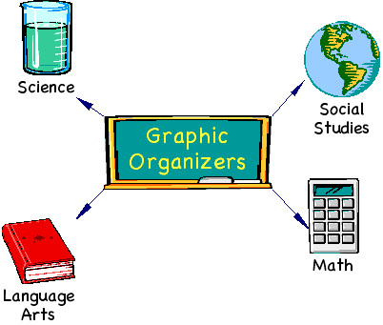
Graphic organizers illustrate concepts and relationships between concepts in a text or using diagrams. Graphic organizers are known by different names, such as maps, webs, graphs, charts, frames, or clusters.

Slide 7
Graphic organizers help students by:
Providing students with tools they can use to examine and show relationships in a text.
Adapted from Adler, C.R. (Ed). 2001. Put Reading First: The Research Building Blocks for Teaching Children to Read, pp. 49-54. National Institute for Literacy. Retrieved Nov. 1, 2007, from http://www.nifl.gov/partnershipforreading/publications/reading_first1text.html.

Slide 8
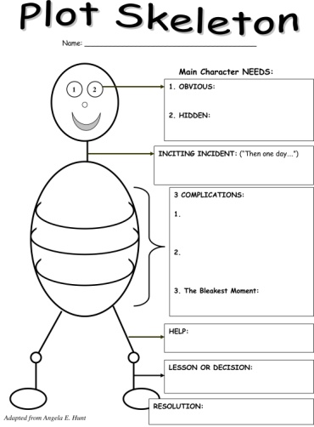
As a tool to support students’ thinking and learning processes, 29 research studies have shown that graphic organizers help students:
• brainstorm ideas.
• develop, organize, and communicate ideas.
• see connections, patterns, and relationships.
• assess and share prior knowledge.
• develop vocabulary.
• outline for writing process activities.
• highlight important ideas.
• classify or categorize concepts, ideas, and information.
• comprehend the events in a story or book.
• improve social interaction between students, and facilitate group work and collaboration among peers.
• guide review and study.
• improve reading comprehension skills and strategies.
• facilitate recall and retention.
The Institute for the Advancement of Research in Education (IARE)

Slide 9
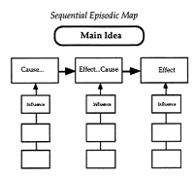
Graphic Organizers Can Also:
Help students focus on text structure "differences between fiction and nonfiction" as they read
Help students write well-organized summaries of a text

Slide 10
Here are some examples of graphic organizers you may already use:
Venn Diagrams
Used to compare or contrast information from two sources. For example, comparing two Dr. Seuss books.
Storyboard/Chain of Events
Used to order or sequence events within a text. For example, listing the steps for brushing your teeth.
Story Map
Used to chart the story structure. These can be organized into fiction and nonfiction text structures. For example, defining characters, setting, events, problem, resolution in a fiction story; however in a nonfiction story, main idea and details would be identified.
Cause/Effect
Used to illustrate the cause and effects told within a text. For example, staying in the sun too long may lead to a painful sunburn

Slide 11
Now we have something for you…
As a part of the development of our professional learning community, we have two bins full of graphic organizers for you to not only use, but to add your favorites for other KM teachers to use as well.
Feel free to copy those that you would like to use to with your students and return the master copy to the bin.
Please add your favorites that you use for others. Make a copy, put it in the appropriate reading skill or strategy file folder, and put a big “M” for master copy on it with a yellow highlighter.
Your cohorts and Dine and Dish hosts…
Kendra and Marjorie

